Slide 1
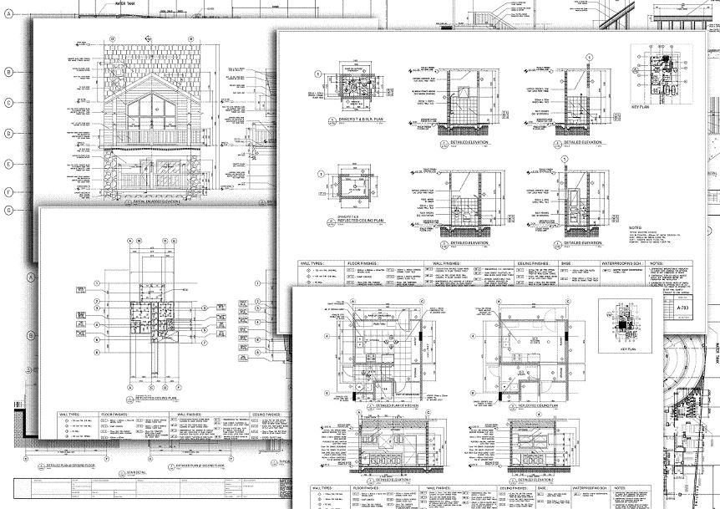
Drawing Document - Advanced
Presenter
Developer Technical Services

Slide 2
Agenda
Drawing Sketches
Drawing Styles
Annotative Objects
Skecthed Symbols
Drawing BOM

Slide 3
Drawing Sketches
The DrawingSketch object supports the same drawing entities and constraints as a part’s PlanarSketch object.
Instead of 3D positioning information it supports drawing specific transformation functions: DrawingViewtoModelSpace, DrawingViewToModelTransform, DrawingViewtoSheetSpace, DrawingViewToSheetTransform, ModelToDrawingViewSpace, ModelToDrawingViewTransform, ModelToSheetSpace, ModelToSheetTransform, SheetToDrawingViewSpace, SheetToDrawingViewTransform, SheetToModelSpace, SheetToModelTransfrom

Slide 4
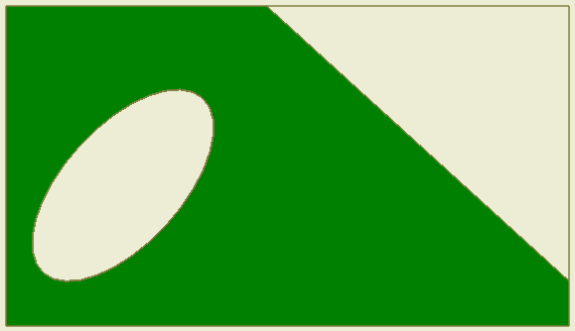
Drawing Sketches
Sketches can be created that are associated with a sheet, a drawing view, and the various definition objects.
Drawing sketches must be open in the user interface before editing. You can query without opening them.
Can set line type, scale, weight, and color of sketch entities.
Ability to color fill a closed sketch. This uses the same Profile object used to create features in part.

Slide 5
Drawing Sketch Example
Public Sub CreateSketch()
Dim oDoc As DrawingDocument
oDoc = _InvApplication.ActiveDocument
Dim oSheet As Sheet
oSheet = oDoc.ActiveSheet
' Create the sketch.
Dim oSketch As DrawingSketch
oSketch = oSheet.Sketches.Add
' Open the sketch for edit in the user interface.
oSketch.Edit()
' add one sketch circle
oSketch.SketchCircles.AddByCenterRadius( _
_InvApplication.TransientGeometry.CreatePoint2d(8, 8), 2)
' Exit edit.
oSketch.ExitEdit()
End Sub
Notes:
Public Sub CreateSketch()
Dim oDoc As DrawingDocument
Set oDoc = ThisApplication.ActiveDocument
Dim oSheet As Sheet
Set oSheet = oDoc.ActiveSheet
' Create the sketch.
Dim oSketch As DrawingSketch
Set oSketch = oSheet.Sketches.Add
' Open the sketch for edit in the user interface.
oSketch.Edit
Call oSketch.SketchCircles.AddByCenterRadius( _
ThisApplication.TransientGeometry.CreatePoint2d(8, 8), 2)
' Exit edit.
oSketch.ExitEdit
End Sub

Slide 6
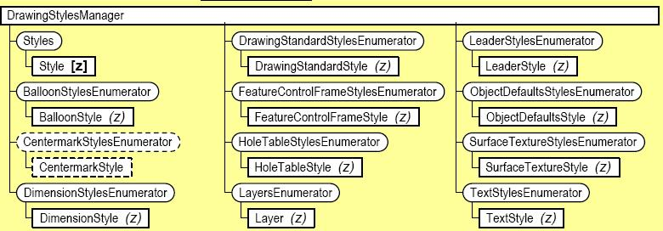
Drawing Styles
Can create, query, and edit:
Dimension style and TextStyle
Feature control frames and styles
Surface texture symbols and styles
Hole tables and styles
Leader style and Balloon style
Parts list, revision, custom tables and styles
Notes:
[z] base class object & (z) derived object
Dotted Circle – New object in Inventor 2010

Slide 7
Dimension Styles
DimensionStyle object provides read/write access to the additional properties that control the display of a dimension.

Slide 8
Create Drawing Style
Get the styles collection of corresponding style
Copy from the existing style
Public Sub CreateStyles()
Dim oDoc As DrawingDocument
oDoc = _InvApplication.ActiveDocument
'get Drawing Styles Manager
Dim oDStylesMan As DrawingStylesManager
oDStylesMan = oDoc.StylesManager
' create a new text style
' by copying from an existing style
'the new name is "MyNewTextStyle"
Dim oNewTextStyle As TextStyle
oNewTextStyle = oDStylesMan.TextStyles("Label Text (ANSI)").Copy("MyNewTextStyle")
' change some properties of the new style
oNewTextStyle.FontSize *= 2
oNewTextStyle.Italic = True
End Sub

Slide 9
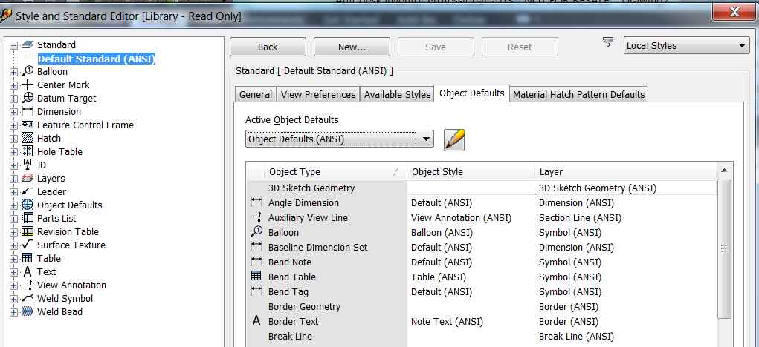
Drawing Standard and Object Defaults Style
DrawingStandardStyle
represents a drawing standard
Contains the general settings of style and object styles (ObjectDefaultsStyle)
Each DrawingStandardStyle has only one ObjectDefaultsStyle
DrawingStylesManager.ActiveStandardStyle
Current active standard style
When you activate a standard, you also set the active ObjectDefaultsStyle

Slide 10
Create Drawing Style Example
Continue with the codes in slide 7
'get Drawing Styles Manager
Dim oNewDrawingStyle As DrawingStandardStyle
oNewDrawingStyle = oDStylesMan.StandardStyles(1).Copy("MyNewDSStyle")
'change some general settings
oNewDrawingStyle.LinearUnits = UnitsTypeEnum.kCentimeterLengthUnits
Dim oNewObjDefaultStyle As ObjectDefaultsStyle
oNewObjDefaultStyle = oDStylesMan.ObjectDefaultsStyles(1).Copy("MyNewObjStyles")
'change some properties
' e.g. the border text style uses the MyNewTextStyle
oNewObjDefaultStyle.BorderTextStyle = oNewTextStyle
'new standard style uses the new objects styles
oNewDrawingStyle.ActiveObjectDefaults = oNewObjDefaultStyle
' the document uses the new DrawingStandardStyle
oDStylesMan.ActiveStandardStyle = oNewDrawingStyle

Slide 11
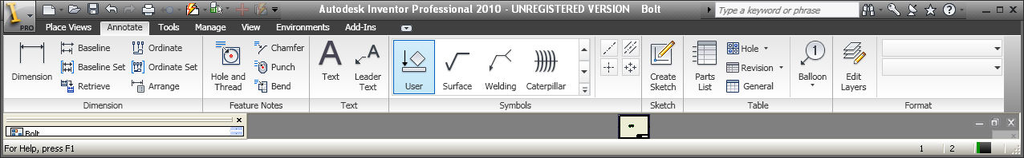
Annotative Objects
Creation of baseline and ordinate dimension and dimension sets.
Automated creation of centerlines and center marks.
Additional center mark and centerline functionality, including styles.
Access dimension and extension lines of a dimension to attach annotations
Creation of bend, chamfer, hole/thread, and punch notes.
Notes:
Creation of baseline and ordinate dimension sets.
Creation of bend, chamfer, hole/thread, and punch notes.

Slide 12
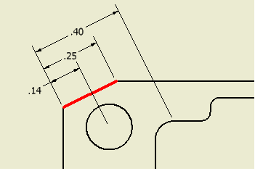
Baseline Dimension Set
BaselineDimensionSets.Add
GeometryIntents: ObjectCollection containing GeometryIntent objects
PlacementPoint : specifies the placement point of the dimension set on the sheet
DimensionType: type of dimension such as horizontal/vertical/diametric dimension
' Create a vertical baseline set dimension.
Dim oBaselineSet As BaselineDimensionSet
oBaselineSet = oBaselineSets.Add(oIntentCollection, oPlacementPoint, DimensionTypeEnum.kHorizontalDimensionType)
Notes:
Public Sub CreateBaselineDimensionSet()
Dim oDrawDoc As DrawingDocument
oDrawDoc = _InvApplication.ActiveDocument
Dim oActiveSheet As Sheet
oActiveSheet = oDrawDoc.ActiveSheet
Dim oIntentCollection As ObjectCollection
oIntentCollection = _InvApplication.TransientObjects.CreateObjectCollection
' Get all the selected drawing curve segments.
Dim oDrawingCurveSegment As DrawingCurveSegment
Dim oDrawingCurve As DrawingCurve
For Each oDrawingCurveSegment In oDrawDoc.SelectSet
' Set a reference to the drawing curve.
oDrawingCurve = oDrawingCurveSegment.Parent
Dim oDimIntent As GeometryIntent
oDimIntent = oActiveSheet.CreateGeometryIntent(oDrawingCurve)
Call oIntentCollection.Add(oDimIntent)
Next
' Set a reference to the view to which the curve belongs.
Dim oDrawingView As DrawingView
oDrawingView = oDrawingCurve.Parent
' Set a reference to the baseline dimension sets collection.
Dim oBaselineSets As BaselineDimensionSets
oBaselineSets = oActiveSheet.DrawingDimensions.BaselineDimensionSets
' Determine the placement point
Dim oPlacementPoint As Point2d
oPlacementPoint = _InvApplication.TransientGeometry.CreatePoint2d(oDrawingView.Left - 5, oDrawingView.Center.Y)
' Create a vertical baseline set dimension.
Dim oBaselineSet As BaselineDimensionSet
oBaselineSet = oBaselineSets.Add(oIntentCollection, oPlacementPoint, DimensionTypeEnum.kVerticalDimensionType)
End Sub

Slide 13
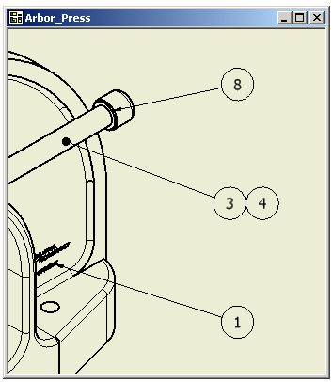
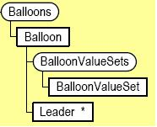
Balloons
Create, Edit and Query existing Balloon
Balloon position and direction
Balloon value (Item Number) from BOM
Balloon override text
Balloon type
Balloon Style
Delete capability
Editing the value also changes the item number within the parts list.
Item number in balloon can be used with BOM to find associated document.

Slide 14
Create Balloons
DrawDocument.DrawingBOMs.IsDrawingBOMDefined
whether BOM properties have been defined in the drawing for the input model.
Balloons.Add
Main arguments:
LeaderPoints : ObjectCollection containing a series of Point2d objects representing the leader originating at the note. The last item in the collection (even if it is the only item) must be a GeometryIntent object indicating a geometry to attach the leader to.
Level : Optional input PartsListLevelEnum that sets the view type for the parts list
BalloonStyle : Optional input BalloonStyle object that specifies the balloon style to use for the balloon
Notes:
Public Sub CreateBalloon()
' Set a reference to the drawing document.
' This assumes a drawing document is active.
Dim oDrawDoc As DrawingDocument
oDrawDoc = _InvApplication.ActiveDocument
' Set a reference to the active sheet.
Dim oActiveSheet As Sheet
oActiveSheet = oDrawDoc.ActiveSheet
' Set a reference to the drawing curve segment.
' This assumes that a drwaing curve is selected.
Dim oDrawingCurveSegment As DrawingCurveSegment
oDrawingCurveSegment = oDrawDoc.SelectSet.Item(1)
' Set a reference to the drawing curve.
Dim oDrawingCurve As DrawingCurve
oDrawingCurve = oDrawingCurveSegment.Parent
' Get the mid point of the selected curve
' assuming that the selection curve is linear
Dim oMidPoint As Point2d
oMidPoint = oDrawingCurve.MidPoint
' Set a reference to the TransientGeometry object.
Dim oTG As TransientGeometry
oTG = _InvApplication.TransientGeometry
Dim oLeaderPoints As ObjectCollection
oLeaderPoints = _InvApplication.TransientObjects.CreateObjectCollection
' Create a couple of leader points.
Call oLeaderPoints.Add(oTG.CreatePoint2d(oMidPoint.X + 10, oMidPoint.Y + 10))
Call oLeaderPoints.Add(oTG.CreatePoint2d(oMidPoint.X + 10, oMidPoint.Y + 5))
' Add the GeometryIntent to the leader points collection.
' This is the geometry that the balloon will attach to.
Dim oGeometryIntent As GeometryIntent
oGeometryIntent = oActiveSheet.CreateGeometryIntent(oDrawingCurve)
Call oLeaderPoints.Add(oGeometryIntent)
' Set a reference to the parent drawing view of the selected curve
Dim oDrawingView As DrawingView
oDrawingView = oDrawingCurve.Parent
' Set a reference to the referenced model document
Dim oModelDoc As Document
oModelDoc = oDrawingView.ReferencedDocumentDescriptor.ReferencedDocument
' Check if a partslist or a balloon has already been created for this model
Dim IsDrawingBOMDefined As Boolean
IsDrawingBOMDefined = oDrawDoc.DrawingBOMs.IsDrawingBOMDefined(oModelDoc.FullFileName)
Dim oBalloon As Balloon
If IsDrawingBOMDefined Then
' Just create the balloon with the leader points
' All other arguments can be ignored
oBalloon = oDrawDoc.ActiveSheet.Balloons.Add(oLeaderPoints)
Else
' First check if the 'structured' BOM view has been enabled in the model
' Set a reference to the model's BOM object
Dim oBOM As BOM
oBOM = oModelDoc.ComponentDefinition.BOM
If oBOM.StructuredViewEnabled Then
' Level needs to be specified
' Numbering options have already been defined
' Get the Level ('All levels' or 'First level only')
' from the model BOM view - must use the same here
Dim Level As PartsListLevelEnum
If oBOM.StructuredViewFirstLevelOnly Then
Level = PartsListLevelEnum.kStructured
Else
Level = PartsListLevelEnum.kStructuredAllLevels
End If
' Create the balloon by specifying just the level
oBalloon = oActiveSheet.Balloons.Add(oLeaderPoints, , Level)
Else
' Level and numbering options must be specified
' The corresponding model BOM view will automatically be enabled
Dim oNumberingScheme As NameValueMap
oNumberingScheme = _InvApplication.TransientObjects.CreateNameValueMap
' Add the option for a comma delimiter
oNumberingScheme.Add("Delimiter", ",")
' Create the balloon by specifying the level and numbering scheme
oBalloon = oActiveSheet.Balloons.Add(oLeaderPoints, , PartsListLevelEnum.kStructuredAllLevels, oNumberingScheme)
End If
End If
End Sub

Slide 15
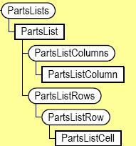
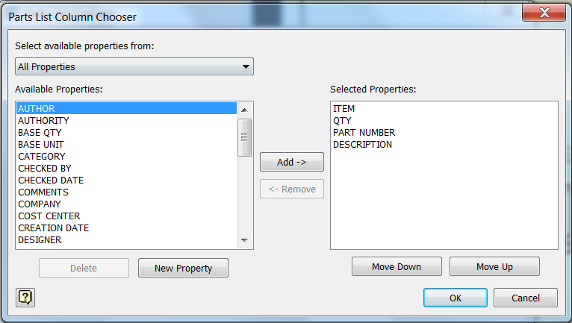
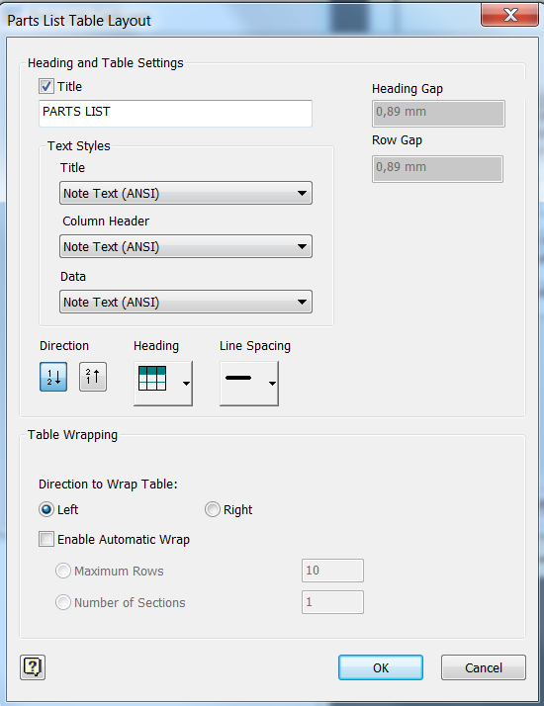
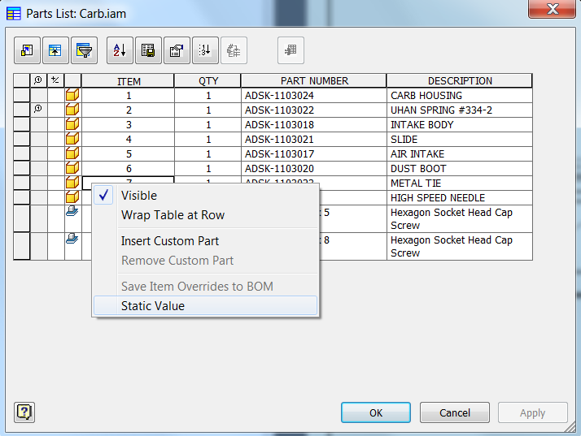
Parts List
The API exposes most of the parts list functionality.

Slide 16
Create Parts List
PartsLists.Add
Main arguments:
ViewOrModel: Input object that specifies the source for the parts list. This can either be a DrawingView object or a Document object
Level: Optional input enum that sets the type of numbering for the parts list
Notes:
Public Sub CreatePartsList()
On Error Resume Next
' Set a reference to the drawing document.
' This assumes a drawing document is active.
Dim oDrawDoc As DrawingDocument
oDrawDoc = _InvApplication.ActiveDocument
'Set a reference to the active sheet.
Dim oSheet As Sheet
oSheet = oDrawDoc.ActiveSheet
' Set a reference to the first drawing view on
' the sheet. This assumes the first drawing
' view on the sheet is not a draft view.
Dim oDrawingView As DrawingView
oDrawingView = oSheet.DrawingViews(1)
' Set a reference to th sheet's border
Dim oBorder As Border
oBorder = oSheet.Border
Dim oPlacementPoint As Point2d
If Not oBorder Is Nothing Then
' A border exists. The placement point
' is the top-right corner of the border.
oPlacementPoint = oBorder.RangeBox.MaxPoint
Else
' There is no border. The placement point
' is the top-right corner of the sheet.
oPlacementPoint = _InvApplication.TransientGeometry.CreatePoint2d(oSheet.Width, oSheet.Height)
End If
' Create the parts list.
Dim oPartsList As PartsList
oPartsList = oSheet.PartsLists.Add(oDrawingView, oPlacementPoint)
End Sub

Slide 17
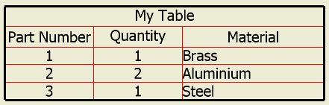
Custom Tables
CustomTables, CustomTable
Supports the creation and edit of a table.
The end-user can modify the table size and the size of rows and columns interactively.
Create a table based on Excel table
Create a sheet metal bend table
Create a configuration (iPart or iAssembly) table
Additional formatting options
Notes:
Public Sub CreateCustomTable()
' Set a reference to the drawing document.
' This assumes a drawing document is active.
Dim oDrawDoc As DrawingDocument
oDrawDoc = ThisApplication.ActiveDocument
' Set a reference to the active sheet.
Dim oSheet As Sheet
oSheet = oDrawDoc.ActiveSheet
' Set the column titles
Dim oTitles(1 To 3) As String
oTitles(1) = "Part Number"
oTitles(2) = "Quantity"
oTitles(3) = "Material"
' Set the contents of the custom table (contents are set row-wise)
Dim oContents(1 To 9) As String
oContents(1) = "1"
oContents(2) = "1"
oContents(3) = "Brass"
oContents(4) = "2"
oContents(5) = "2"
oContents(6) = "Aluminium"
oContents(7) = "3"
oContents(8) = "1"
oContents(9) = "Steel"
' Set the column widths (defaults to the column title width if not specified)
Dim oColumnWidths(1 To 3) As Double
oColumnWidths(1) = 2.5
oColumnWidths(2) = 2.5
oColumnWidths(3) = 4
' Create the custom table
Dim oCustomTable As CustomTable
oCustomTable = oSheet.CustomTables.Add("My Table", ThisApplication.TransientGeometry.CreatePoint2d(15, 15), _
3, 3, oTitles, oContents, oColumnWidths)
' Change the 3rd column to be left justified.
oCustomTable.Columns.Item(3).ValueHorizontalJustification = kAlignTextLeft
' Create a table format object
Dim oFormat As TableFormat
oFormat = oSheet.CustomTables.CreateTableFormat
' Set inside line color to red.
oFormat.InsideLineColor = ThisApplication.TransientObjects.CreateColor(255, 0, 0)
' Set outside line weight.
oFormat.OutsideLineWeight = 0.1
' Modify the table formats
oCustomTable.OverrideFormat = oFormat
End Sub

Slide 18
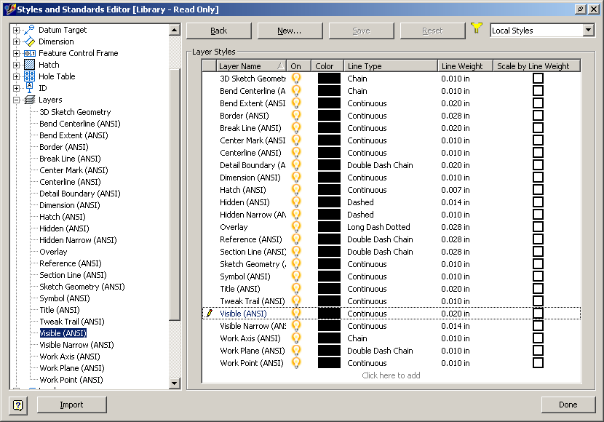
Layers in Drawings
Creation of layers (by copying an existing layer).
Access and edit existing layers
Set the layer associated with a specific entity. Limited to the entities currently supported by the API.
Sketch Entities, Dimensions, Balloons, Parts Lists, Revision Blocks, Custom Table, and Sketched Symbols

Slide 19
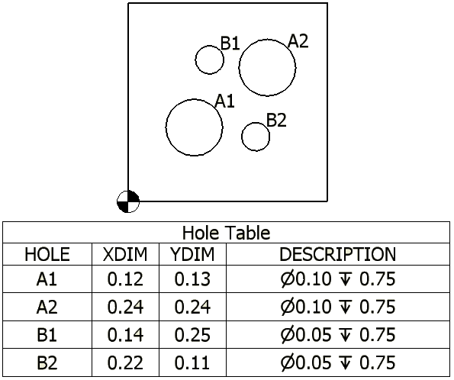
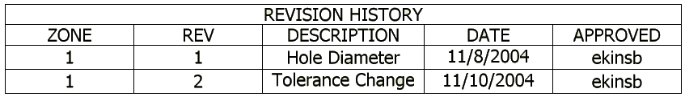
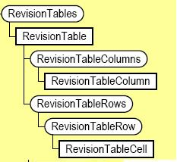
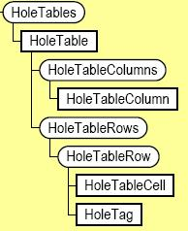
Revision and Hole Tables
Place new tables onto a sheet.
Query existing tables.
Edit existing rows and add new rows.
Access to associated hole tag.
Notes:
Public Sub RevisionTableQuery()
' Set a reference to the drawing document.
' This assumes a drawing document is active.
Dim oDrawDoc As DrawingDocument
oDrawDoc = _InvApplication.ActiveDocument
' Set a reference to the first revision table on the active sheet.
' This assumes that a revision table is on the active sheet.
Dim oRevTable As RevisionTable
oRevTable = oDrawDoc.ActiveSheet.RevisionTables.Item(1)
' Iterate through the contents of the revision table.
Dim i As Long
For i = 1 To oRevTable.RevisionTableRows.Count
' Get the current row.
Dim oRow As RevisionTableRow
oRow = oRevTable.RevisionTableRows.Item(i)
' Iterate through each column in the row.
Dim j As Long
For j = 1 To oRevTable.RevisionTableColumns.Count
' Get the current cell.
Dim oCell As RevisionTableCell
oCell = oRow.Item(j)
' Display the value of the current cell.
Debug.Print("Row: " & i & ", Column: " & oRevTable.RevisionTableColumns.Item(j).Title & " = " & oCell.Text)
Next
Next
'add a new row
Dim oNewRow As RevisionTableRow
oNewRow = oRevTable.RevisionTableRows.Add()
End Sub

Slide 20
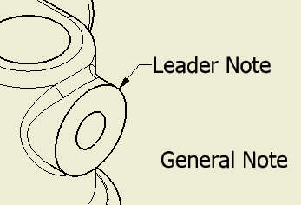
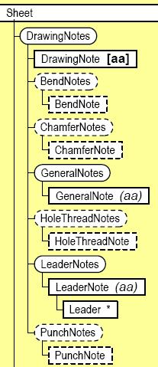
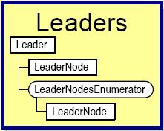
Notes
Uses same xml formatting supported by sketch text.
General Notes
Text placed on the sheet.
Leader Notes
Text with a leader.
Uses GeometryIntent to define the location where the leader is pointing.
Notes:
''' <remarks></remarks>
Public Sub AddLeaderNote()
' Set a reference to the drawing document.
' This assumes a drawing document is active.
Dim oDrawDoc As DrawingDocument
oDrawDoc = _InvApplication.ActiveDocument
' Set a reference to the active sheet.
Dim oActiveSheet As Sheet
oActiveSheet = oDrawDoc.ActiveSheet
' Set a reference to the drawing curve segment.
' This assumes that a drawing curve is selected.
Dim oDrawingCurveSegment As DrawingCurveSegment
oDrawingCurveSegment = oDrawDoc.SelectSet.Item(1)
' Set a reference to the drawing curve.
Dim oDrawingCurve As DrawingCurve
oDrawingCurve = oDrawingCurveSegment.Parent
' Get the mid point of the selected curve
' assuming that the selected curve is linear
Dim oMidPoint As Point2d
oMidPoint = oDrawingCurve.MidPoint
' Set a reference to the TransientGeometry object.
Dim oTG As TransientGeometry
oTG = _InvApplication.TransientGeometry
Dim oLeaderPoints As ObjectCollection
oLeaderPoints = _InvApplication.TransientObjects.CreateObjectCollection
' Create a few leader points.
Call oLeaderPoints.Add(oTG.CreatePoint2d(oMidPoint.X + 10, oMidPoint.Y + 10))
Call oLeaderPoints.Add(oTG.CreatePoint2d(oMidPoint.X + 10, oMidPoint.Y + 5))
' Create an intent and add to the leader points collection.
' This is the geometry that the leader text will attach to.
Dim oGeometryIntent As GeometryIntent
oGeometryIntent = oActiveSheet.CreateGeometryIntent(oDrawingCurve)
Call oLeaderPoints.Add(oGeometryIntent)
' Create text with simple string as input. Since this doesn't use
' any text overrides, it will default to the active text style.
Dim sText As String
sText = "API Leader Note"
Dim oLeaderNote As LeaderNote
oLeaderNote = oActiveSheet.DrawingNotes.LeaderNotes.Add(oLeaderPoints, sText)
' Insert a node.
Dim oFirstNode As LeaderNode
oFirstNode = oLeaderNote.Leader.RootNode.ChildNodes.Item(1)
Dim oSecondNode As LeaderNode
oSecondNode = oFirstNode.ChildNodes.Item(1)
Call oFirstNode.InsertNode(oSecondNode, oTG.CreatePoint2d(oMidPoint.X + 5, oMidPoint.Y + 5))
End Sub

Slide 21
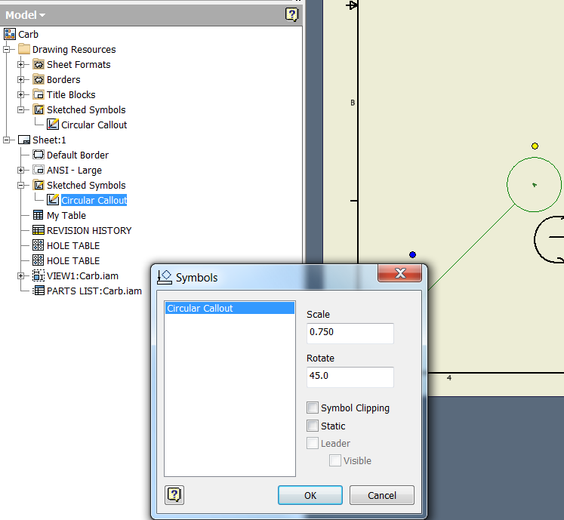

Sketched Symbols
Sketched symbol definitions.
Defined as a sketch.
Supports prompted text.
Sketched symbol instances.
An instance of a sketched symbol definition.
Can specify scale and rotation during placement and editing.
Can create with a leader. Uses GeometryIntent to define the location of the leader.
Notes:
''' <summary>
''' creating a new sketched symbol definition object '''
''' </summary>
''' <remarks></remarks>
Public Sub CreateSketchedSymbolDefinition()
' Set a reference to the drawing document.
' This assumes a drawing document is active.
Dim oDrawDoc As DrawingDocument
oDrawDoc = _InvApplication.ActiveDocument
' Create the new sketched symbol definition.
Dim oSketchedSymbolDef As SketchedSymbolDefinition
oSketchedSymbolDef = oDrawDoc.SketchedSymbolDefinitions.Add("Circular Callout")
' Open the sketched symbol definition's sketch for edit. This is done by calling the Edit
' method of the SketchedSymbolDefinition to obtain a DrawingSketch. This actually creates
' a copy of the sketched symbol definition's and opens it for edit.
Dim oSketch As DrawingSketch
Call oSketchedSymbolDef.Edit(oSketch)
Dim oTG As TransientGeometry
oTG = _InvApplication.TransientGeometry
' Use the functionality of the sketch to add sketched symbol graphics.
Dim oSketchLine As SketchLine
oSketchLine = oSketch.SketchLines.AddByTwoPoints(oTG.CreatePoint2d(0, 0), oTG.CreatePoint2d(20, 0))
Dim oSketchCircle As SketchCircle
oSketchCircle = oSketch.SketchCircles.AddByCenterRadius(oTG.CreatePoint2d(22, 0), 2)
Call oSketch.GeometricConstraints.AddCoincident(oSketchLine.EndSketchPoint, oSketchCircle)
' Make the starting point of the sketch line the insertion point
oSketchLine.StartSketchPoint.InsertionPoint = True
' Add a prompted text field at the center of the sketch circle.
Dim sText As String
sText = "<Prompt>Enter text 1</Prompt>"
Dim oTextBox As TextBox
oTextBox = oSketch.TextBoxes.AddFitted(oTG.CreatePoint2d(22, 0), sText)
oTextBox.VerticalJustification = VerticalTextAlignmentEnum.kAlignTextMiddle
oTextBox.HorizontalJustification = HorizontalTextAlignmentEnum.kAlignTextCenter
Call oSketchedSymbolDef.ExitEdit(True)
End Sub
''' <summary>
''' insert a sketched symbol by the definition above
''' </summary>
''' <remarks></remarks>
Public Sub InsertSketchedSymbolOnSheet()
' Set a reference to the drawing document.
' This assumes a drawing document is active.
Dim oDrawDoc As DrawingDocument
oDrawDoc = _InvApplication.ActiveDocument
' Obtain a reference to the desired sketched symbol definition.
Dim oSketchedSymbolDef As SketchedSymbolDefinition
oSketchedSymbolDef = oDrawDoc.SketchedSymbolDefinitions.Item("Circular Callout")
Dim oSheet As Sheet
oSheet = oDrawDoc.ActiveSheet
' This sketched symbol definition contains one prompted string input. An array
' must be input that contains the strings for the prompted strings.
Dim sPromptStrings(0) As String
sPromptStrings(0) = "A"
Dim oTG As TransientGeometry
oTG = _InvApplication.TransientGeometry
' Add an instance of the sketched symbol definition to the sheet.
' Rotate the instance by 45 degrees and scale by .75 when adding.
' The symbol will be inserted at (0,0) on the sheet. Since the
' start point of the line was marked as the insertion point, the
' start point should end up at (0,0).
Dim oSketchedSymbol As SketchedSymbol
oSketchedSymbol = oSheet.SketchedSymbols.Add(oSketchedSymbolDef, oTG.CreatePoint2d(0, 0), (3.14159 / 4), 0.75, sPromptStrings)
End Sub

Slide 22
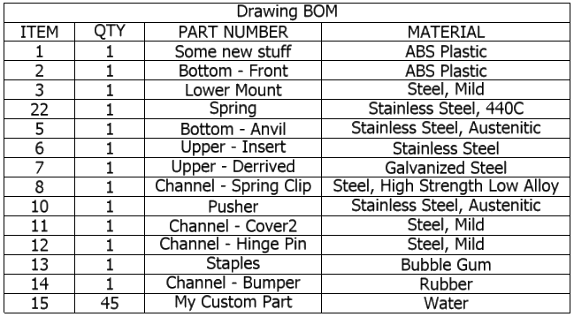
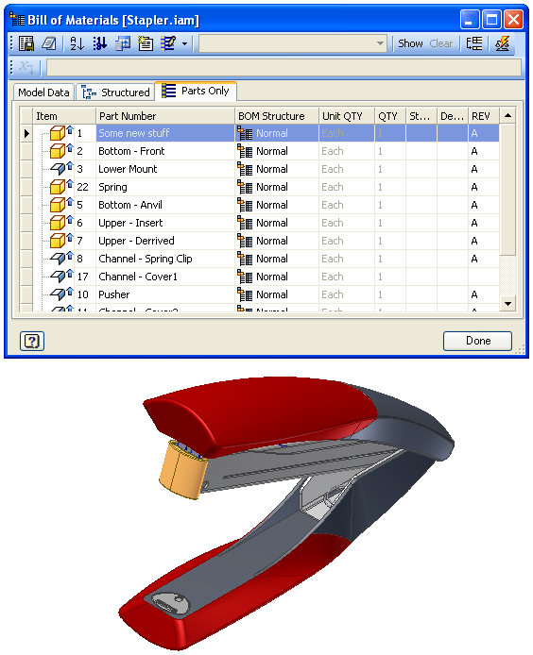
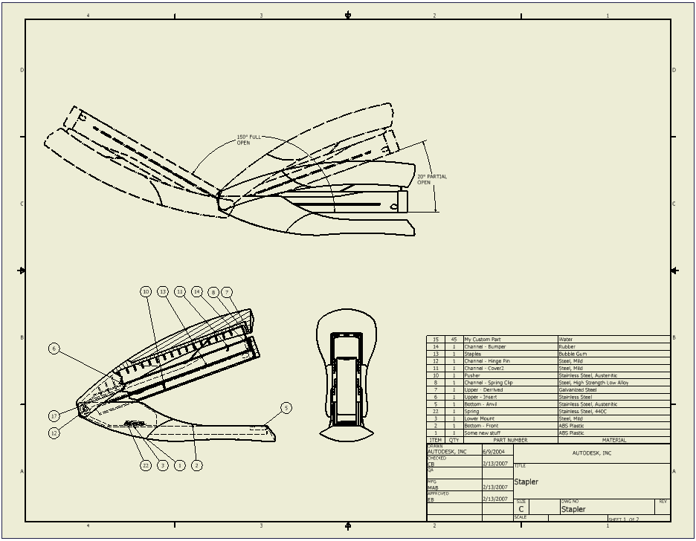
Drawing Bill of Material
Access to drawing BOM
Access components referenced by balloon or parts list.
Parts list (export, rotate, copy, etc.)

Slide 23

Notes:
Thank you!
Questions?

